Slide 1
Copyright

Slide 2



Our web pages now have images!

Slide 3
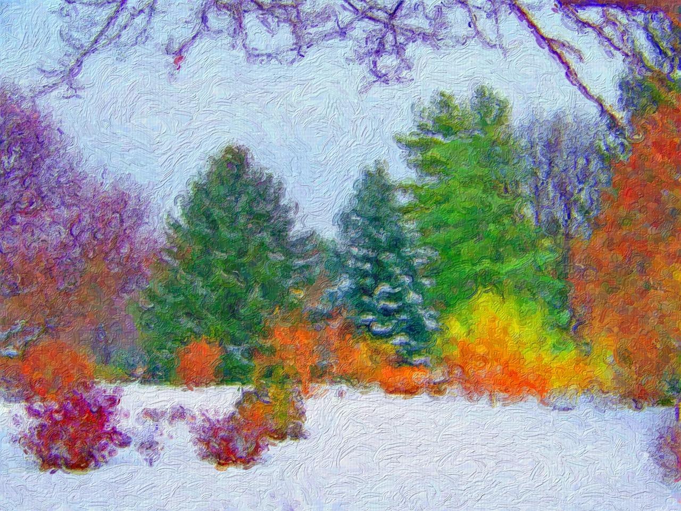
Some of these images may belong to someone else
Source: David Wagner. Trees in the Snow Painting. 2017. PublicDomainPictures.net (http://www.publicdomainpictures.net/view-image.php?image=12741)

Slide 4
Some of these images may belong to someone else
It’s important to cite your sources!
Source: David Wagner. Trees in the Snow Painting. 2017. PublicDomainPictures.net (http://www.publicdomainpictures.net/view-image.php?image=12741)

Slide 5
Copyright
Copyright is a form of protection for intellectual property, usually applying to artistic works
Any work of original thought is the legal property of the creator, and this is protected by copyright law

Slide 6
Respecting Others’ Copyright
Distributing copyrighted materials (images, movies, albums) over file-sharing networks is a clear violation
Putting an image on your site and passing it off as your own is also a violation of copyright law!

Slide 7
Respecting Others’ Copyright
The safest choice is to cite your sources!
Name of the author, if available
Name of the work, if available
Year of the work, if available
Name of the site you sourced it from
Direct link

Slide 8
Copyright Licenses
There are several types of copyright licenses, some offering more protection than others

Slide 9
Copyright Licenses
All rights reserved
Some rights reserved
Public domain

Slide 10
Copyright Licenses
All rights reserved
Creator reserves all rights
Some rights reserved
Creator may allow for things like reuse or modifications as long as they are cited as the creator
Public domain
Creator has dedicated the work to the public domain and waived all rights

Slide 11
Copyright Licenses
We’ll want to mostly use works in the public domain
All rights reserved
Creator reserves all rights
Some rights reserved
Creator may allow for things like reuse or modifications as long as they are cited as the creator
Public domain
Creator has dedicated the work to the public domain and waived all rights

Slide 12
Finding Images You Can Use
Pixabay
pixabay.com
PublicDomainPictures.net
www.publicdomainpictures.net

Slide 13
Finding Images You Can Use
Google image search filters

Slide 14
Let’s see some examples!

